Slide 1

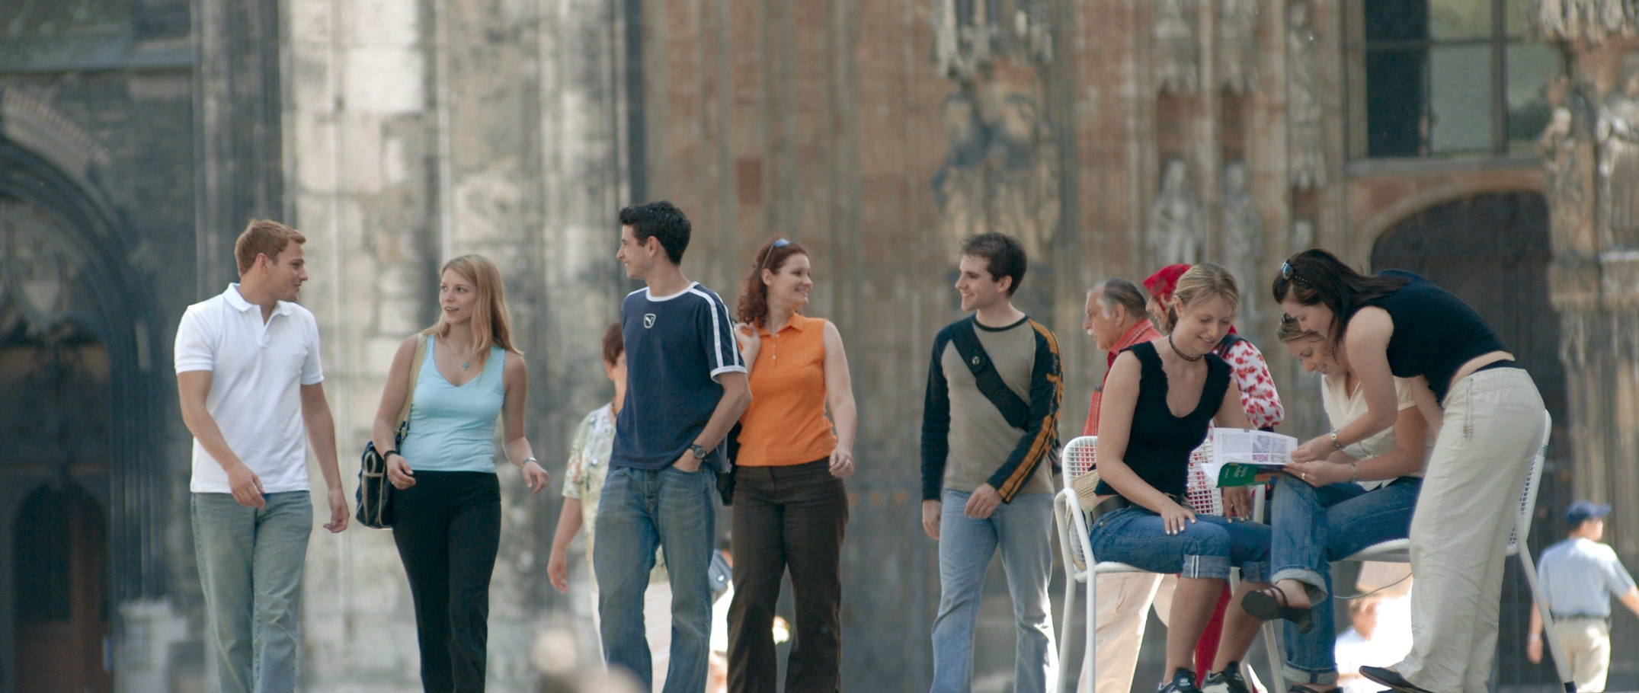
Mobile Human Computer Interaction I
Der einarmige Mexsicó
Johann Albach, Sebastian Hartwig, Kaith Menken, Daniel Eischer

Slide 2
Technologie today

Slide 3
Technologie today

Slide 4
T o d aayayyya

Slide 5
Look into the Future

Slide 6
Look into the Future

Slide 7
Look into the Future

Slide 8
introduction

Slide 9
Introduction
Single handed

Slide 10
Key features

Slide 11
Key features

Slide 12
Key features

Slide 13
Key features

Slide 14
Key features

Slide 15
Implementation

